Slide 1
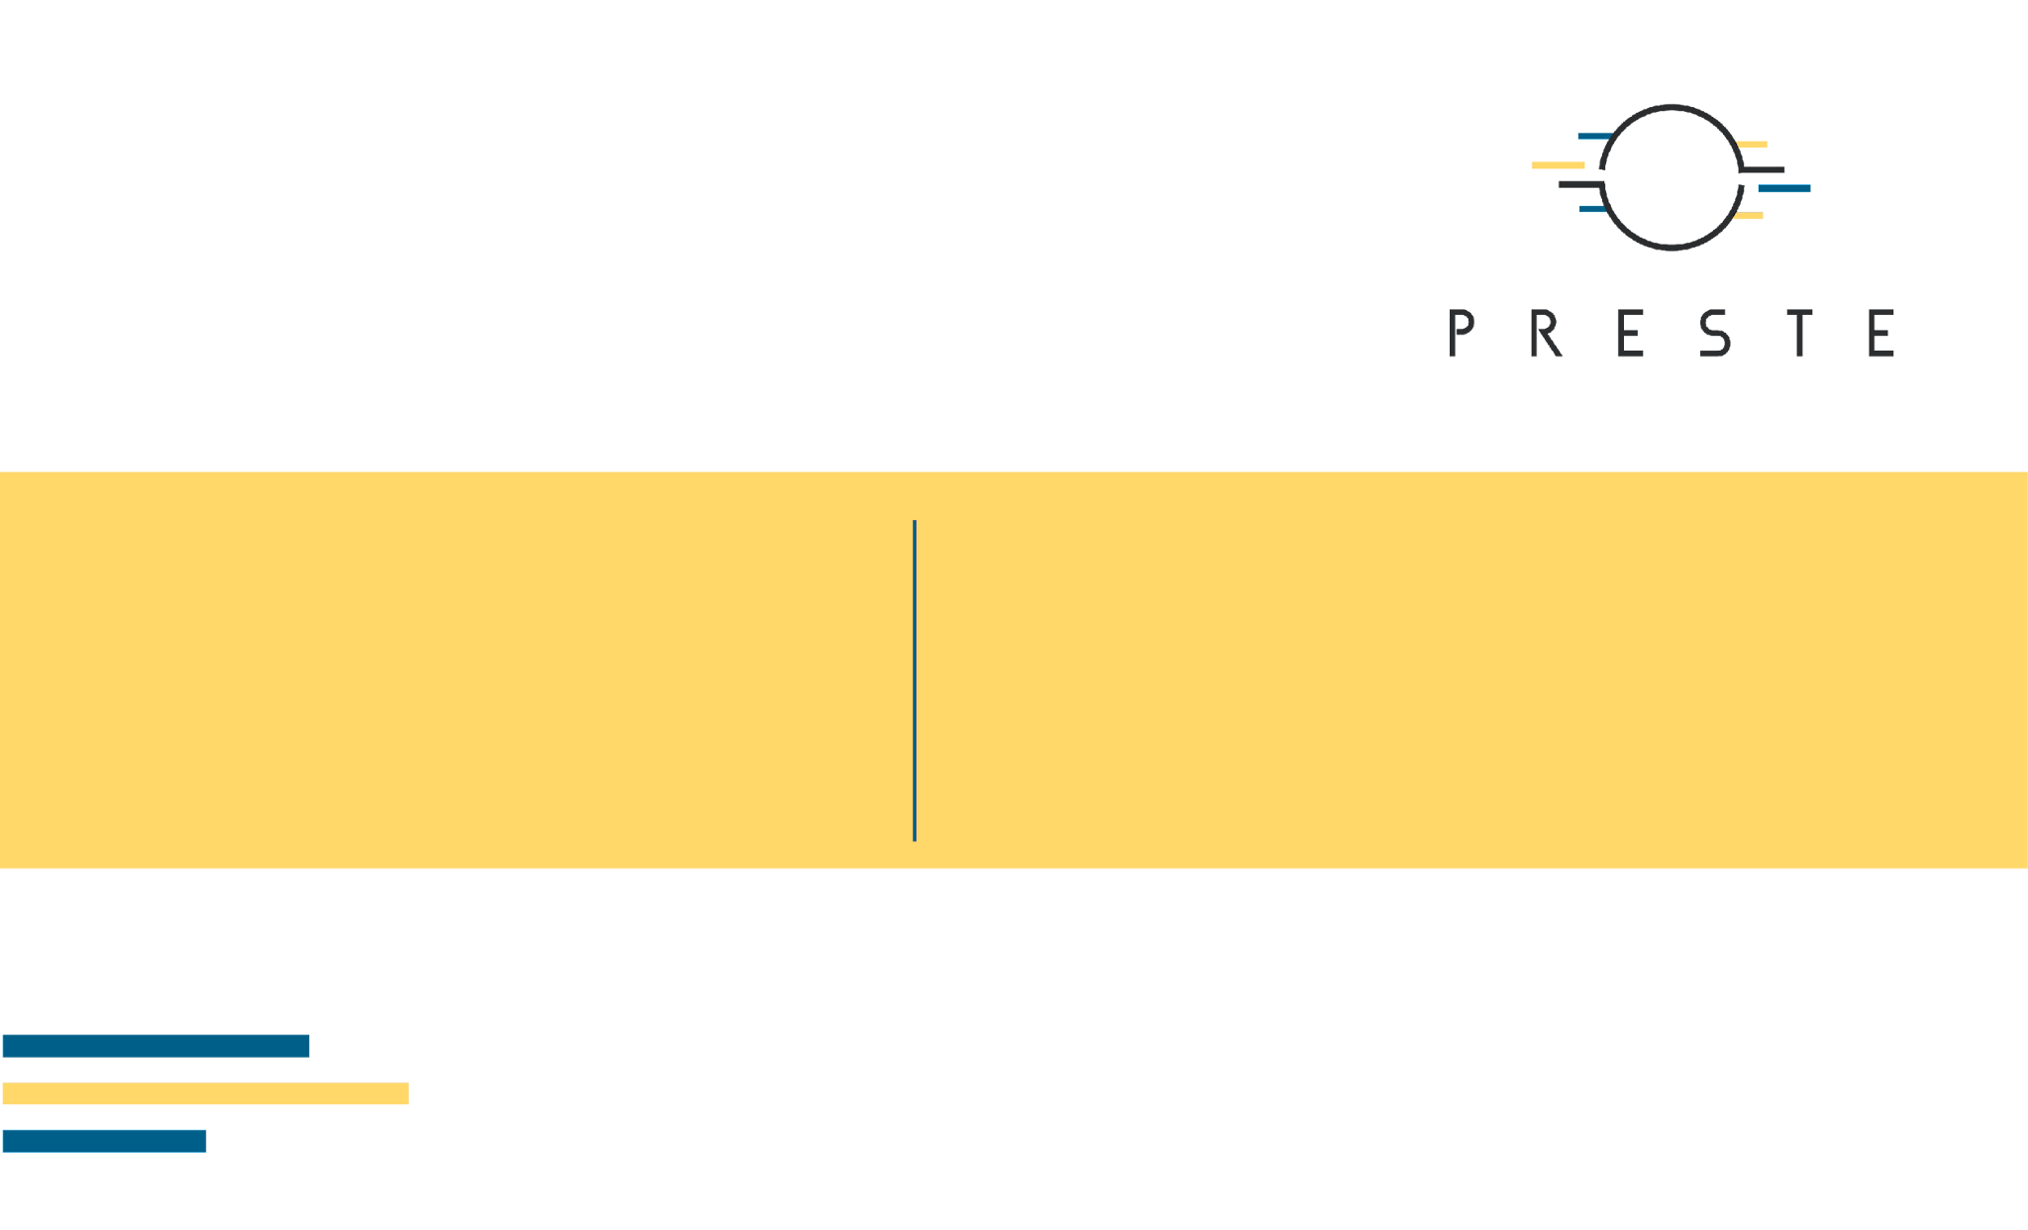
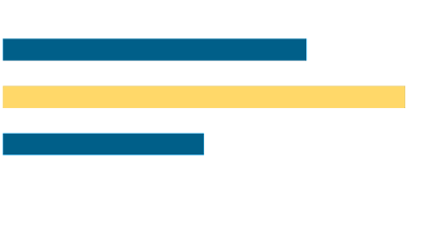
Graphs and
Graph Neural
Networks
From nodes and edges to learned graph representations
1/58

Slide 2

What's for today
Why graphs are a distinct machine-learning data type.
Graph fundamentals: nodes, edges, attributes and adjacency.
How molecules and other biological systems become graphs.
Message passing, aggregation and node embeddings.
GCN, GraphSAGE, GAT and GIN as representative GNN architectures.
Knowledge distillation: teacher and student models.
Node-, edge- and graph-level prediction.
Graph pooling and mini-batching with PyTorch Geometric.
Molecular graph regression on the ESOL dataset.
Machine Learning for Bioinformatics · Lecture 9
2/58

Slide 3

1. Why graphs?
Relationships can be part of the data rather than something the model must infer from a fixed grid.
Machine Learning for Bioinformatics · Lecture 9
3/58

Slide 4
From vectors and grids to relationships
MLPs assume a fixed-length feature vector.
CNNs assume a regular spatial grid.
RNNs/Transformers assume an ordered sequence.
Graphs represent objects together with explicit relationships.
The number of nodes and connections can vary between samples.
Four ways to organize data
Vector
Image grid
0.2
0.7
0.1
Sequence
Graph
A
C
G
Graphs make relationships explicit, with variable connectivity.
Machine Learning for Bioinformatics · Lecture 9
4/58

Slide 5
Many biological systems are naturally graphs
Molecules: atoms connected by chemical bonds.
Protein–protein interaction networks.
Gene-regulatory and metabolic networks.
Cell–cell graphs in spatial transcriptomics.
Neuronal and brain-connectivity networks.
Machine Learning for Bioinformatics · Lecture 9
5/58

Slide 6
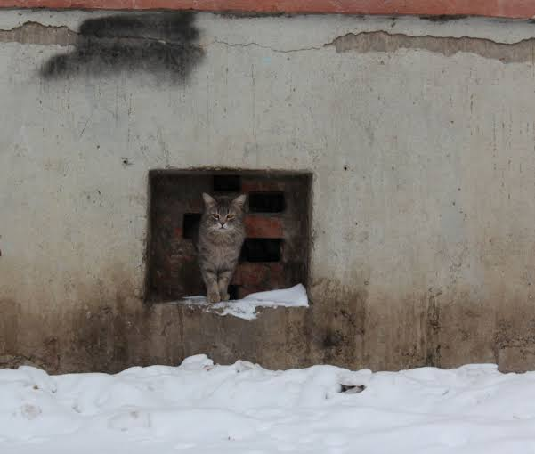
2. Graph fundamentals
A graph is defined by entities, relationships and optional attributes on both.
Machine Learning for Bioinformatics · Lecture 9
6/58

Slide 7
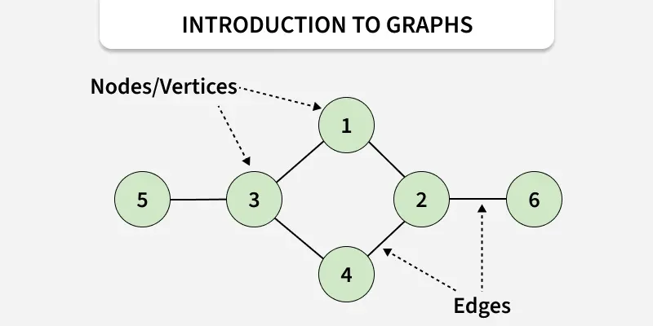
What is a graph?
G = (V, E)
V is the set of nodes or vertices.
E is the set of edges between nodes.
Nodes and edges may also carry feature vectors.
A graph may describe one object or a whole interaction network.
Machine Learning for Bioinformatics · Lecture 9
7/58

Slide 8
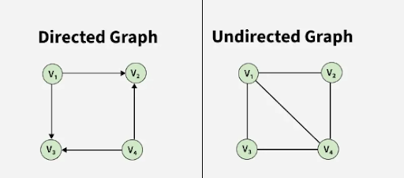
Directed and undirected graphs
Undirected
Directed
No orientation.
Example: many molecular bonds.
u ↔ v
Source and target matter.
Example: TF → regulated gene.
u → v
Machine Learning for Bioinformatics · Lecture 9
8/58

Slide 9
Node and edge attributes
Node feature: xᵥ ∈ ℝᵈ.
Edge feature: eᵤᵥ ∈ ℝᵏ.
Structure tells us who is connected.
Features tell us what each node or edge is.
Structure plus attributes
Node x₀
[element=C, charge=0]
Node x₂
[element=O, charge=0]
C
C
O
Edge e₁₂: [bond order=1]
Illustrative feature fields for ethanol; hydrogens are implicit.
Machine Learning for Bioinformatics · Lecture 9
9/58

Slide 10
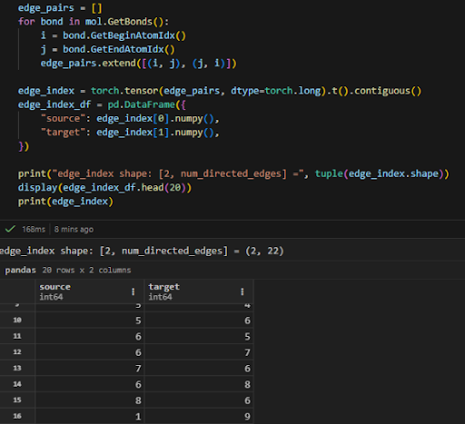
Adjacency matrix
Aᵢⱼ = 1 if (i,j) ∈ E, otherwise 0
Aᵢⱼ records whether node i is connected to node j.
For an undirected graph, A is symmetric.
The matrix shape is N × N.
Dense adjacency is wasteful for sparse biological graphs.
Machine Learning for Bioinformatics · Lecture 9
10/58

Slide 11
Sparse graph representation
Most real graphs contain far fewer edges than N² possible connections.
Instead of storing zeros, keep only existing edges.
An edge list is compact and efficient.
PyTorch Geometric stores this as edge_index.
Connectivity, stored two ways
0
1
2
3
4
0 — 1
0 — 4
1 — 2
1 — 3
2 — 3
3 — 4
0
0
1
0
0
1
1
1
0
1
1
0
2
0
1
0
1
0
3
0
1
1
0
1
4
1
0
0
1
0
25 matrix entries
6 undirected edges
Machine Learning for Bioinformatics · Lecture 9
11/58

Slide 12
3. Biological systems as graphs
Molecules, neural systems, spatial cells and pathways
Machine Learning for Bioinformatics · Lecture 9
12/58

Slide 13
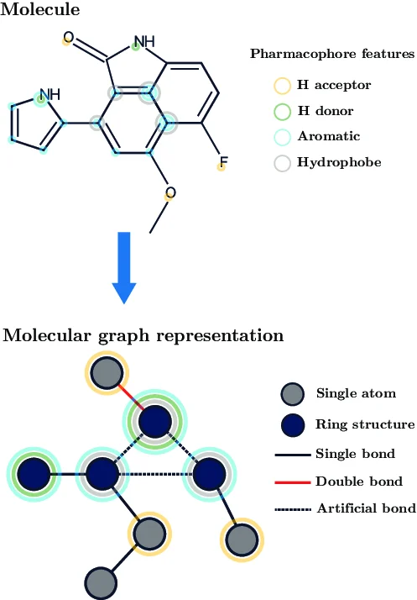
A molecule is a graph
Atoms → nodes.
Bonds → edges.
Molecules vary naturally in graph size.
Graph connectivity preserves molecular topology.
Machine Learning for Bioinformatics · Lecture 9
13/58

Slide 14
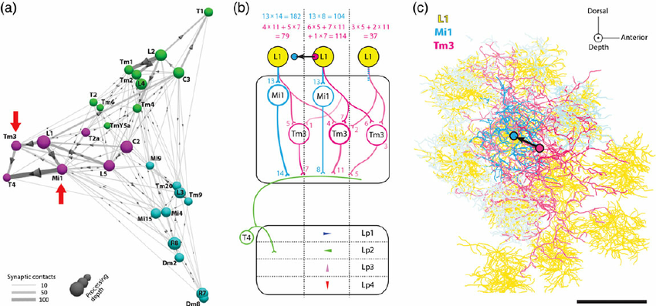
Neural systems as graphs
Nodes can represent individual neurons, neuronal populations or brain regions.
Edges can encode synapses, anatomical connectivity or functional coupling.
Node features may include firing rate, cell type, gene expression or anatomy.
Possible tasks: node classification, connectivity prediction and network-level classification.
Machine Learning for Bioinformatics · Lecture 9
14/58

Slide 15
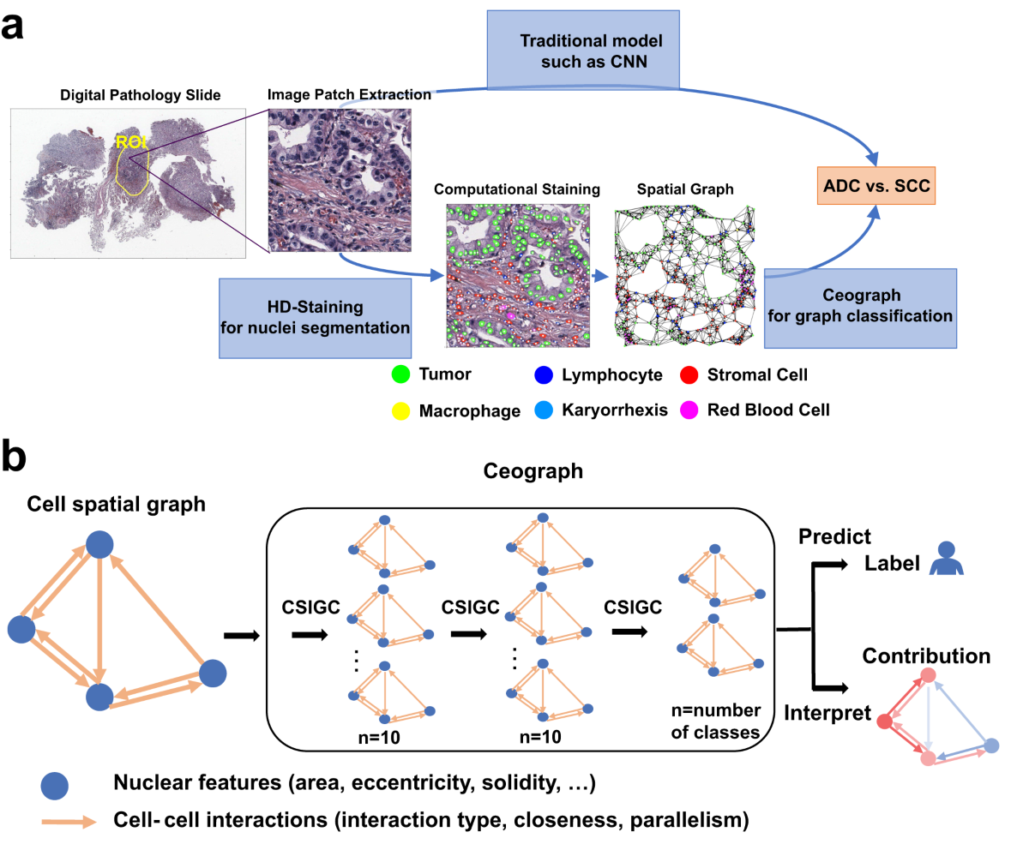
Cells as spatial graphs
Nodes represent cells detected in microscopy or spatial transcriptomics.
Node features can contain marker expression, morphology, intensity or cell type.
Edges can represent physical contact, k-nearest neighbors or a distance threshold.
The graph preserves tissue organization that is lost in an isolated-cell feature table.
Machine Learning for Bioinformatics · Lecture 9
15/58

Slide 16
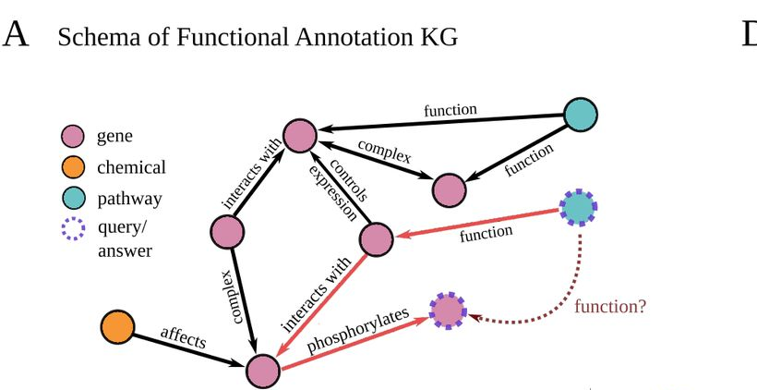
Biological pathways as graphs
Nodes may represent genes, proteins or metabolites.
Edges may encode activation, inhibition, biochemical reactions or physical interactions.
Direction and edge type often carry biological meaning.
Possible tasks include function prediction, pathway perturbation and missing-interaction prediction.
Machine Learning for Bioinformatics · Lecture 9
16/58

Slide 17
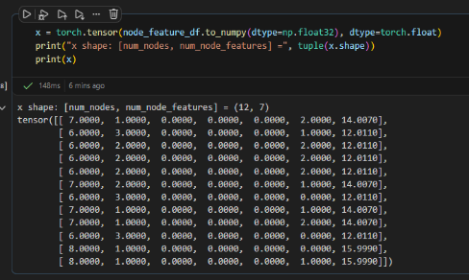
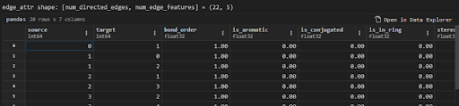
A graph sample in PyTorch Geometric
x stores node features.
edge_index stores graph connectivity.
edge_attr optionally stores edge features.
y stores the target.
One Data object can represent one molecule.
Machine Learning for Bioinformatics · Lecture 9
17/58

Slide 18

4. Message passing
A GNN learns by repeatedly exchanging and aggregating information along graph edges.
Machine Learning for Bioinformatics · Lecture 9
18/58

Slide 19
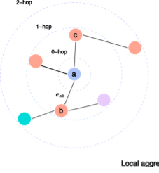
Neighborhood of a node
𝒩(v) = {u : (u,v) ∈ E}
𝒩(v) is the set of nodes connected to v.
A node initially knows only its own features.
Message passing lets it incorporate information from neighbors.
Repeated layers expand the accessible graph context.
Machine Learning for Bioinformatics · Lecture 9
19/58

Slide 20
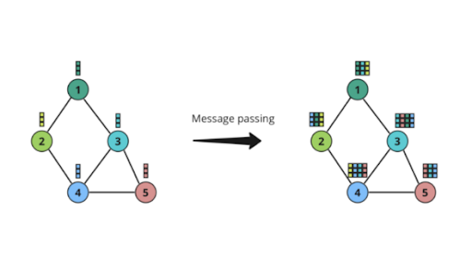
The message-passing idea
Machine Learning for Bioinformatics · Lecture 9
20/58

Slide 21
General message-passing framework
Send → aggregate → update
MESSAGE defines what information is sent across an edge.
AGGREGATE combines messages from neighbors.
UPDATE combines the aggregate with the current node state.
Different GNN families mainly differ in these operations.
u₁
u₂
u₃
MSG 1
MSG 2
MSG 3
AGGREGATE
hᵥ
UPDATE → hᵥ′
Machine Learning for Bioinformatics · Lecture 9
21/58

Slide 22
From node features to node embeddings
At layer 0, the node state is the input feature vector.
After one layer, it contains information from nearby nodes.
After several layers, it becomes a learned contextual representation.
This parallels contextual token embeddings in Transformers.
A node acquires context
xᵥ
hᵥ¹
hᵥ²
Own features
1-hop context
2-hop context
Each layer updates the representation at the same node v.
Machine Learning for Bioinformatics · Lecture 9
22/58

Slide 23
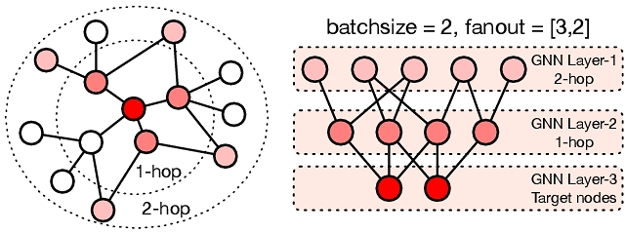
One layer = one-hop information
After one GNN layer, node v incorporates information from its immediate neighbors.
After two layers, information can arrive from nodes two edges away.
After k layers, the receptive field is approximately the k-hop neighborhood.
More layers expand context, but they can also introduce oversmoothing and oversquashing.
Machine Learning for Bioinformatics · Lecture 9
23/58

Slide 24
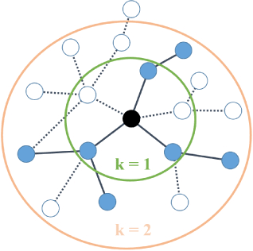
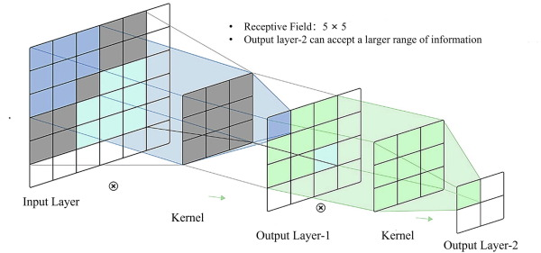
Graph receptive field vs CNN receptive field
CNNs expand across nearby pixels.
GNNs expand across graph neighborhoods.
Both repeatedly combine local information into higher-level features.
Graph neighborhoods are irregular rather than grid-shaped.
Machine Learning for Bioinformatics · Lecture 9
24/58

Slide 25
Permutation-invariant aggregation
The neighbor set has no canonical order.
SUM, MEAN and MAX are permutation invariant.
Aggregation choice affects what structural information is preserved.
Permutation invariance is essential for graph-level consistency.
Aggregate a set of vectors
Neighbor
vectors
1
2
3
0
2
4
SUM
MEAN
MAX
[6, 6]
[2, 2]
[3, 4]
Machine Learning for Bioinformatics · Lecture 9
25/58

Slide 26
Mean vs sum: information can disappear
Different neighborhoods can produce the same mean.
Mean normalizes neighborhood size but can lose multiplicity information.
Sum preserves the number of repeated features.
This is one motivation for sum-based models such as GIN.
Neighborhood A
[1, 1]
Neighborhood B
[1, 1, 1, 1]
MEAN(A) = MEAN(B) = 1
SUM(A) = 2 ≠ SUM(B) = 4
Machine Learning for Bioinformatics · Lecture 9
26/58

Slide 27

5. Graph Convolutional Networks
GCN is a canonical example of normalized neighborhood aggregation.
Machine Learning for Bioinformatics · Lecture 9
27/58

Slide 28
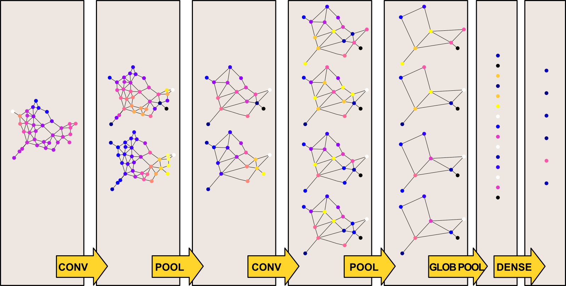
Graph convolution intuition
Each node combines its own representation with neighboring representations.
A learned linear transformation maps the aggregate to a new space.
A nonlinear activation follows.
Stacking layers repeatedly mixes local graph information.
Machine Learning for Bioinformatics · Lecture 9
28/58

Slide 29
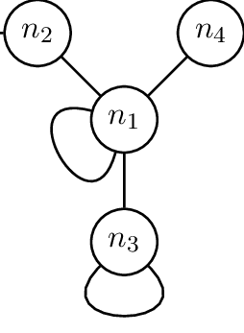
Self-loops?
Without a self-loop, aggregation may ignore the node’s own current state.
Adding I makes each node part of its own neighborhood.
The model combines self-information with neighbor information.
Machine Learning for Bioinformatics · Lecture 9
30/58

Slide 30
Why normalize by degree?
Nodes may have very different numbers of neighbors.
Raw summation can create degree-dependent magnitudes.
GCN normalization balances contributions.
Normalization is part of the architecture’s inductive bias.
Degree changes message scale
Self-loop degree d̃ᵥ = 2
Self-loop degree d̃ᵥ = 5
v
v
1
1
1
1
1
Raw self + neighbors: 2
Raw self + neighbors: 5
Machine Learning for Bioinformatics · Lecture 9
31/58

Slide 31

6. Other GNN families
Most architectures still follow message passing, but they change how neighbors are combined.
Machine Learning for Bioinformatics · Lecture 9
33/58

Slide 32
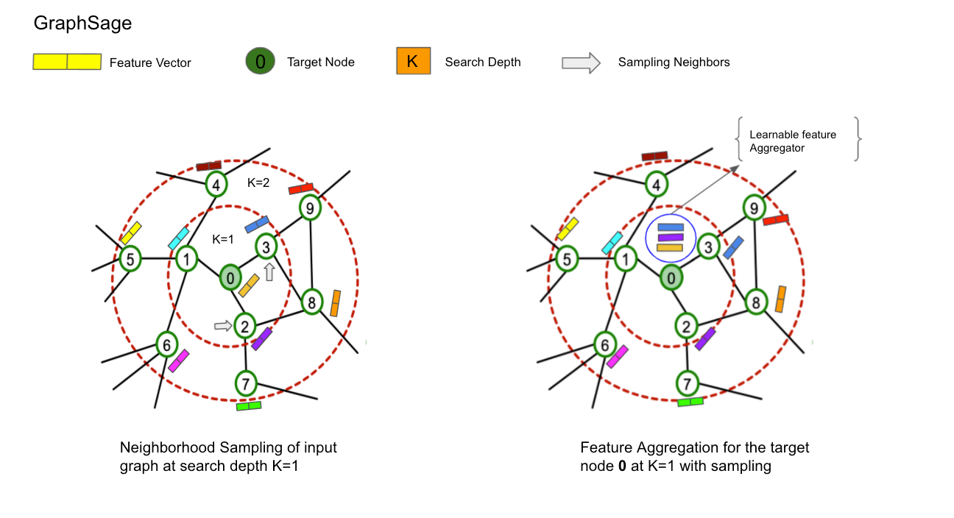
GraphSAGE
Combines a node representation with an aggregated neighborhood representation.
Originally motivated by inductive learning on large graphs.
Can sample neighborhoods rather than process the whole graph.
Useful when new nodes must be embedded.
Machine Learning for Bioinformatics · Lecture 9
34/58

Slide 33
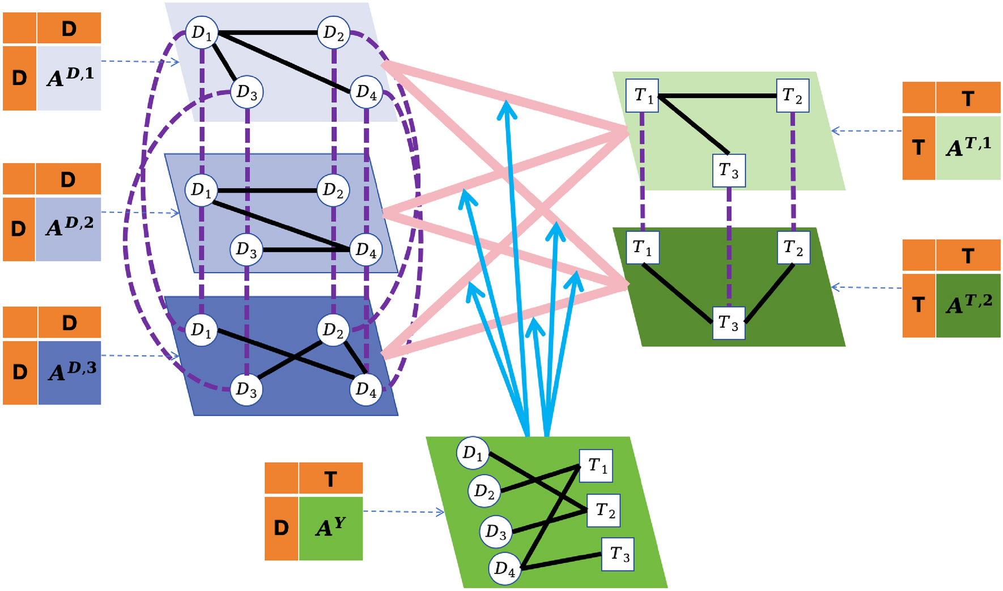
Graph Attention Networks
Different neighbors can receive different learned weights.
Attention coefficients αᵥᵤ control contribution strength.
Attention weights are not automatically biological explanations.
Machine Learning for Bioinformatics · Lecture 9
35/58

Slide 34
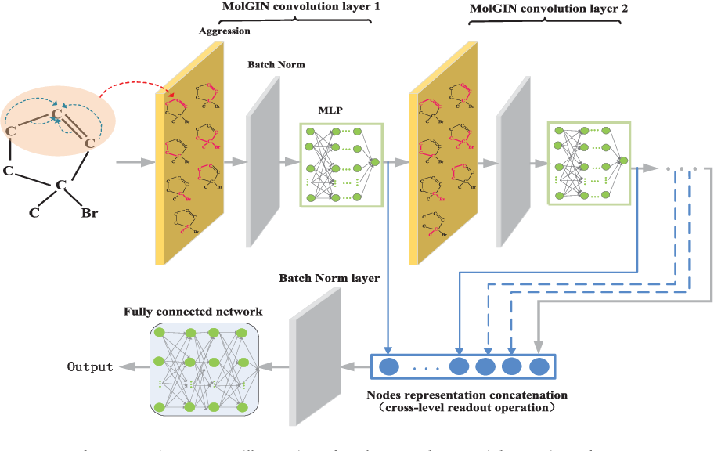
Graph Isomorphism Network
GIN uses sum aggregation followed by an MLP.
Sum preserves multiset information that mean can lose.
GIN is a strong baseline for graph-level molecular tasks.
Machine Learning for Bioinformatics · Lecture 9
36/58

Slide 35
GCN, GraphSAGE, GAT and GIN
Main mechanism
GCN: normalized neighbor aggregation.
GraphSAGE: sampled / inductive neighborhood aggregation.
GAT: learned neighbor weights.
GIN: expressive sum aggregation + MLP.
Machine Learning for Bioinformatics · Lecture 9
37/58

Slide 36

7. Knowledge distillation
A large teacher model can transfer predictive behavior to a smaller student model.
Machine Learning for Bioinformatics · Lecture 9
38/58

Slide 37
Knowledge distillation: teacher → student
Teacher: larger, more expensive model with strong predictive performance.
Student: smaller model optimized for speed, memory or deployment constraints.
The student learns from experimental labels and from the teacher’s predictions.
The teacher is used during training; only the student may be needed at deployment.
Teacher
large model
Input
soft
targets
→
↓
Student
small model
deploy the student
Machine Learning for Bioinformatics · Lecture 9
39/58

Slide 38
Hard labels vs soft teacher targets
A hard label tells the student only which class is correct.
The teacher distribution also contains information about relative class similarity.
Temperature T softens the teacher probabilities.
Training can combine ordinary supervised loss with a distillation loss.
Hard label
[0, 0, 1, 0]
Teacher
[.02,.13,.78,.07]
pᵀ = softmax(z / T)
L = α L_hard + (1−α) T² KL(p_T || p_S)
Higher T → softer probability distribution
Machine Learning for Bioinformatics · Lecture 9
40/58

Slide 39
Distillation also works for regression
For regression, the teacher provides a continuous prediction rather than class probabilities.
The student can learn from both the measured target y and the teacher prediction ŷ_T.
Example: large GIN/ensemble teacher → small 2-layer GCN student.
This becomes useful later when we discuss efficient ML and deployment.
L = α MSE(y, ŷ_S) + (1−α) MSE(ŷ_T, ŷ_S)
Teacher
large GIN
Student
small GCN
→
Same ESOL target: log S
Machine Learning for Bioinformatics · Lecture 9
41/58

Slide 40
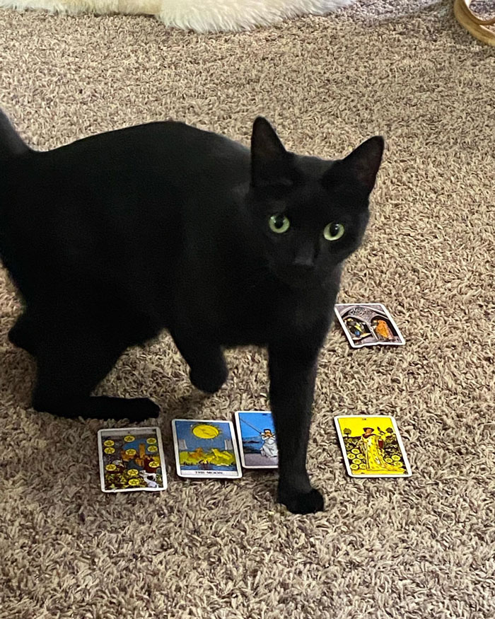
8. What can a GNN predict?
The target can belong to a node, an edge or an entire graph.
Machine Learning for Bioinformatics · Lecture 9
42/58

Slide 41
Node-level prediction
One prediction for each node.
Examples: cell identity, gene function, node state.
Output usually retains one row per node.
Predict a node label
Class: cell type A
v
a
b
c
d
Machine Learning for Bioinformatics · Lecture 9
43/58

Slide 42
Edge-level prediction
Predict a property or existence of a relationship.
Examples: protein–protein interaction, drug–target interaction, link prediction.
Often combines two node embeddings.
Score a candidate relationship
v
a
b
P(v ↔ d) = 0.82
c
d
Machine Learning for Bioinformatics · Lecture 9
44/58

Slide 43
Graph-level prediction
One prediction for the entire graph.
Examples: molecular solubility, toxicity or activity.
Requires a fixed-size representation from variable node counts.
This is the task used in the practical.
A scalar for each molecule
C
O
ŷ₁
C
C
C
ŷ₂
C
O
C
C
O
ŷ₃
C
C
Machine Learning for Bioinformatics · Lecture 9
45/58

Slide 44

9. Graph embeddings
Graph-level prediction requires a fixed-size representation regardless of the number of nodes.
Machine Learning for Bioinformatics · Lecture 9
46/58

Slide 45
Variable graph size
Different molecules contain different numbers of atoms.
After message passing, each molecule still has N node embeddings.
A graph predictor needs one vector per molecule.
Pooling converts node embeddings into a graph embedding.
Different N, the same embedding size
N=3
nodes
1 × d
N=6
nodes
1 × d
Machine Learning for Bioinformatics · Lecture 9
47/58

Slide 46
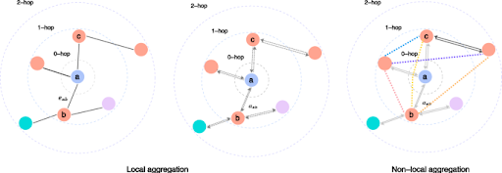
Pool the same node matrix
Global graph pooling
1
2
Three node
embeddings
global_mean_pool averages node embeddings.
global_add_pool sums node embeddings.
global_max_pool keeps the maximum per feature.
Pooling converts a variable-size set of node embeddings into one fixed-size graph vector.
3
0
2
4
MEAN
ADD
MAX
[2,2]
[6,6]
[3,4]
Machine Learning for Bioinformatics · Lecture 9
48/58

Slide 47
From atoms to a molecular property
Atom
features
GCN / GIN
layers
Global
pooling
MLP
ŷ = log S
→
→
→
→
Message passing learns node representations → pooling creates one graph embedding → an ordinary prediction head maps it to the target.
variable-size graph → fixed-size embedding → scalar prediction
Machine Learning for Bioinformatics · Lecture 9
49/58

Slide 48

10. Mini-batching graphs and limiatations
PyTorch Geometric batches variable-size graphs by combining them into one disconnected graph.
Machine Learning for Bioinformatics · Lecture 9
50/58

Slide 49
How can graphs be batched?
Images can be stacked because H and W are fixed.
Graphs have different numbers of nodes and edges.
PyG concatenates them into one disconnected graph.
A batch vector records the original graph of each node.
A batch is a disconnected graph
Machine Learning for Bioinformatics · Lecture 9
51/58

Slide 50
The PyG batch vector
batch[i] stores the graph ID of node i.
Pooling uses batch to aggregate nodes separately for each graph.
N_total × d node embeddings become B × d graph embeddings.
This enables efficient mini-batch graph training.
Track the graph ID of every node
Concatenated nodes: global index
0
1
2
3
4
5
6
7
8
0
0
0
1
1
2
2
2
2
batch = [0,0,0,1,1,2,2,2,2]
Machine Learning for Bioinformatics · Lecture 9
52/58

Slide 51
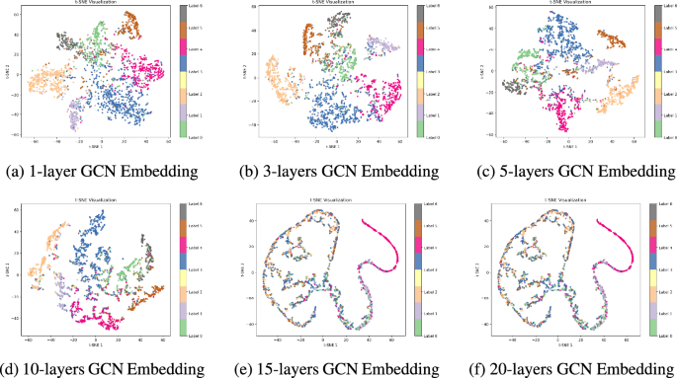
Oversmoothing
Repeated neighbor averaging can make node embeddings increasingly similar.
Very deep message-passing stacks may lose node-specific information.
More GNN layers are not automatically better.
Machine Learning for Bioinformatics · Lecture 9
54/58

Slide 52
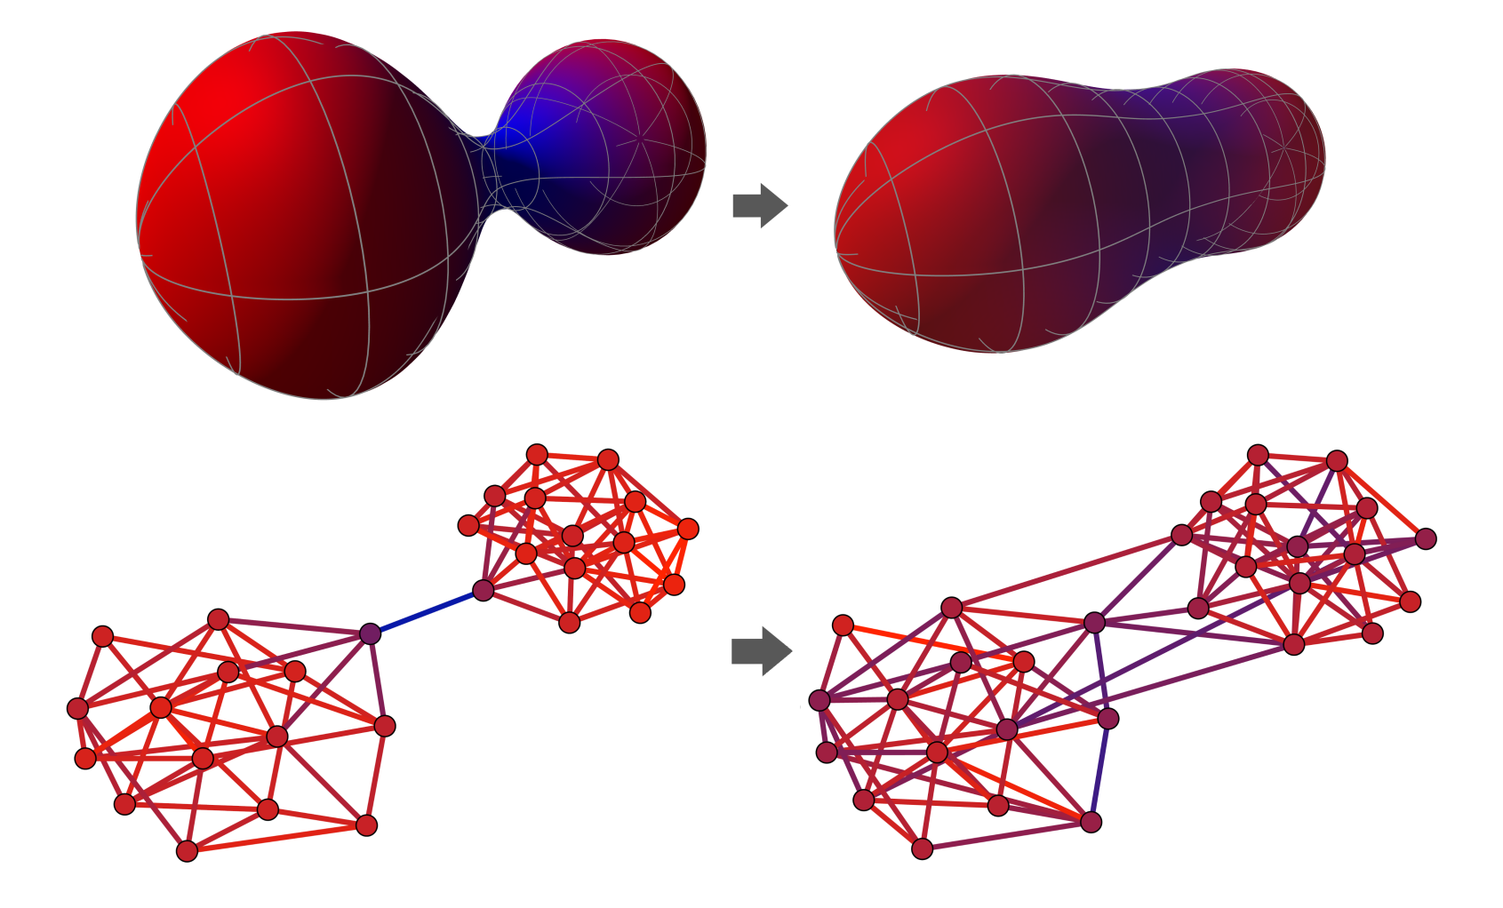
Oversquashing
Information from an expanding neighborhood must be compressed into a fixed-size vector.
Long-range dependencies can be difficult to transmit through graph bottlenecks.
Graph topology affects how information propagates.
Machine Learning for Bioinformatics · Lecture 9
55/58

Slide 53
From graph to prediction
G=(V,E)
Node + edge
features
Message
passing
Node
embeddings
Global
pooling
Graph
embedding
Prediction
→
→
→
→
→
→
The graph defines who can communicate; the GNN learns what information should be propagated and how it should be combined.
Machine Learning for Bioinformatics · Lecture 9
57/58

Slide 54
Practical 9
Dataset: Delaney ESOL.
Input: molecular structure encoded as a graph.
Target: aqueous solubility (log S).
Task: graph-level regression.
Goal: understand the graph pipeline rather than maximize benchmark performance.
Machine Learning for Bioinformatics · Lecture 9
58/58

